Slide 1

RESTURANT FOOD-ORDERING WEBSITE

Slide 2

COURSE TITLE
THIS PRESENTATION IS PREPARED AND PRESENTED BY
SOFTWARE DEVELOPMENT
NAME
JANNATUR NOOR TASPIA
DEPARTMENT
COMPUTER SCIENCE & ENGINEERING
STUDENT ID
2104010202192
NAME
Ruhul Amin
Sharif
STUDENT ID
2104010202265

Slide 3
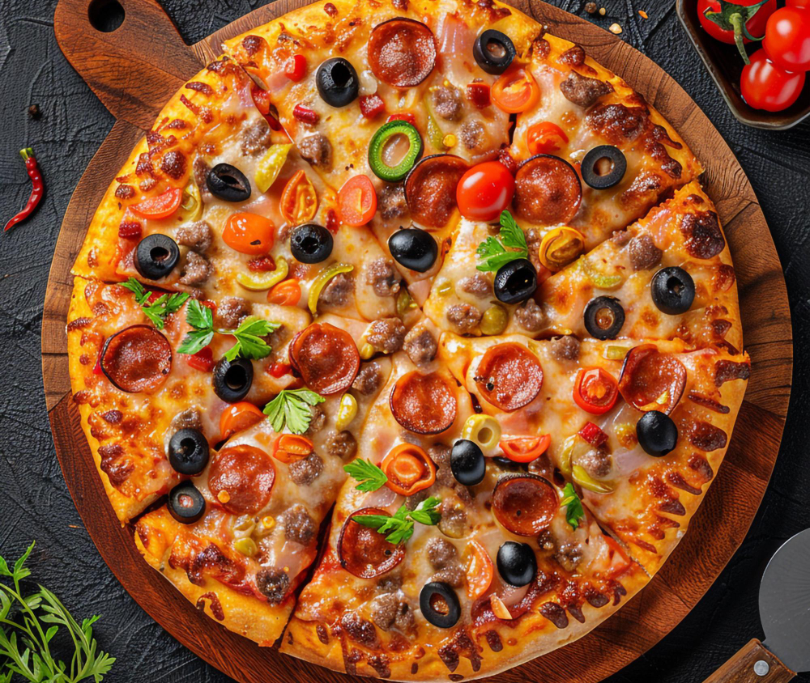
Table of Contents
Introduction
Project Organization
Hardware and Software Requirements
System Architecture
Class Diagram
Project Demonstration
Testing
Limitations
Future Enhancements

Slide 4

Introduction
The platform is designed to provide an online solution for restaurant food ordering, incorporating real-time notifications, flexible menu management, and secure payment processing. It offers customers a seamless ordering experience while providing restaurant owners with advanced tools for managing orders, products, and customer interactions.

Slide 5
Project Organization
Project Scope:
The platform provides a full suite of features for online food ordering:
Customizable drag-and-drop menu builder for easy menu updates.
Live order notifications and order management system.
Advanced product management including discounts, variants, and coupons.
Multiple payment gateways for convenient checkout options.
Modules:
User Authentication and Authorization
Product and Order Management
Payment Processing
Admin Dashboard and Analytics
Customer Features (cart management , Alert system)

Slide 6

1
Development environments
Processor: Intel Core i5 (7th Gen) or AMD Ryzen 5
RAM: 8 GB minimum (16 GB recommended)
Storage: 256 GB SSD or 500 GB HDD (with an additional 1 TB HDD for backups)
Graphics: Integrated or dedicated GPU (NVIDIA GTX series for better performance)
Network: High-speed internet connection
Operating System: Windows 10, macOS, or Linux (Ubuntu or Fedora)
Hardware Requirements
Here we will discuses about our Hardware requirements
1
Server environments
Processor: Quad-core CPU (Intel Xeon or AMD EPYC)
RAM: 16 GB
Storage: 500 GB SSD with RAID for backup
Network: 100 Mbps bandwidth, load balancing, and CDN for high traffic
Operating System: Linux Server (Ubuntu or CentOS)
Additional: UPS for power continuity

Slide 7

1
Software tools
Software Requirements
IDE: Visual Studio Code
Version Control: Git
Backend Framework: Laravel 11, PHP 8.2
Database: MySQL, Apache web server
Frontend: Bootstrap, Vue.js, HTML5, CSS3, JavaScript
Testing: PHPUnit for backend testing
Here we will discuses about our Software requirements
1
External Services
Payment Gateways: Stripe, PayPal
Email Service: Mailtrap for transactional emails

Slide 8
System Architecture
The platform is built using Laravel’s MVC architecture, which separates concerns across the Model, View, and Controller layers.

Slide 9
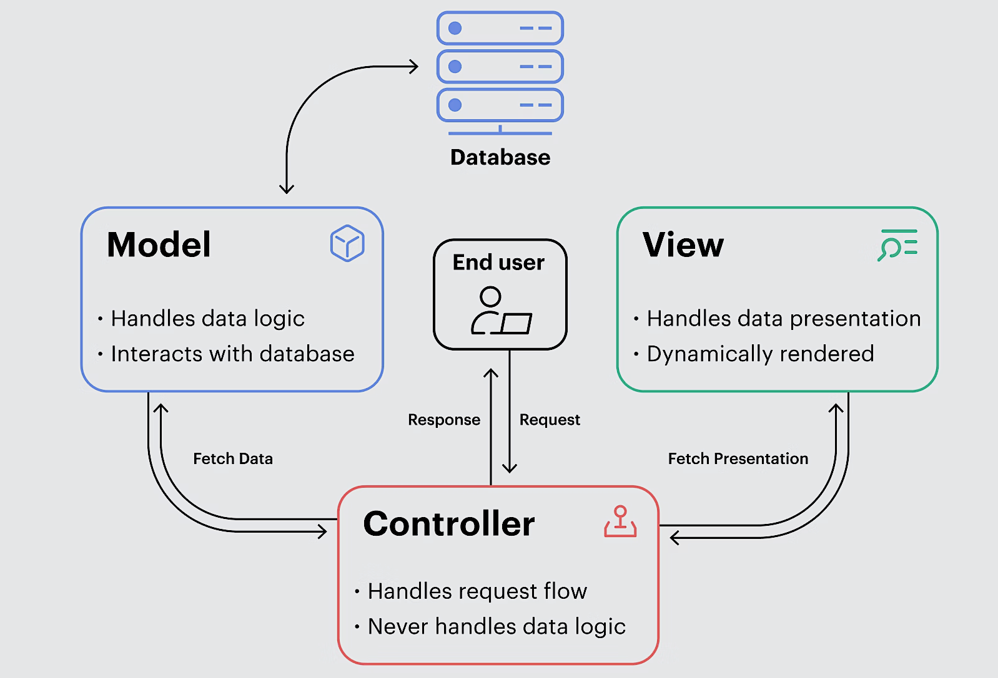
System
Architecture
Modules:
User Interface: Vue.js for dynamic components and Bootstrap for responsive design.
Application Logic: Handled by Laravel Controllers and Services.
Database Layer: Managed with Eloquent ORM and MySQL for efficient data operations.
Data Flow:
Client Requests: Initiated via the frontend.
Backend Processing: Laravel Controllers process requests, utilizing services for business logic.
Response: Data is returned in JSON format or rendered as HTML for the user interface.

Slide 10
Class Diagram
Now we will show the class diagram of the projects where we can see Key Classes and Relationships

Slide 11
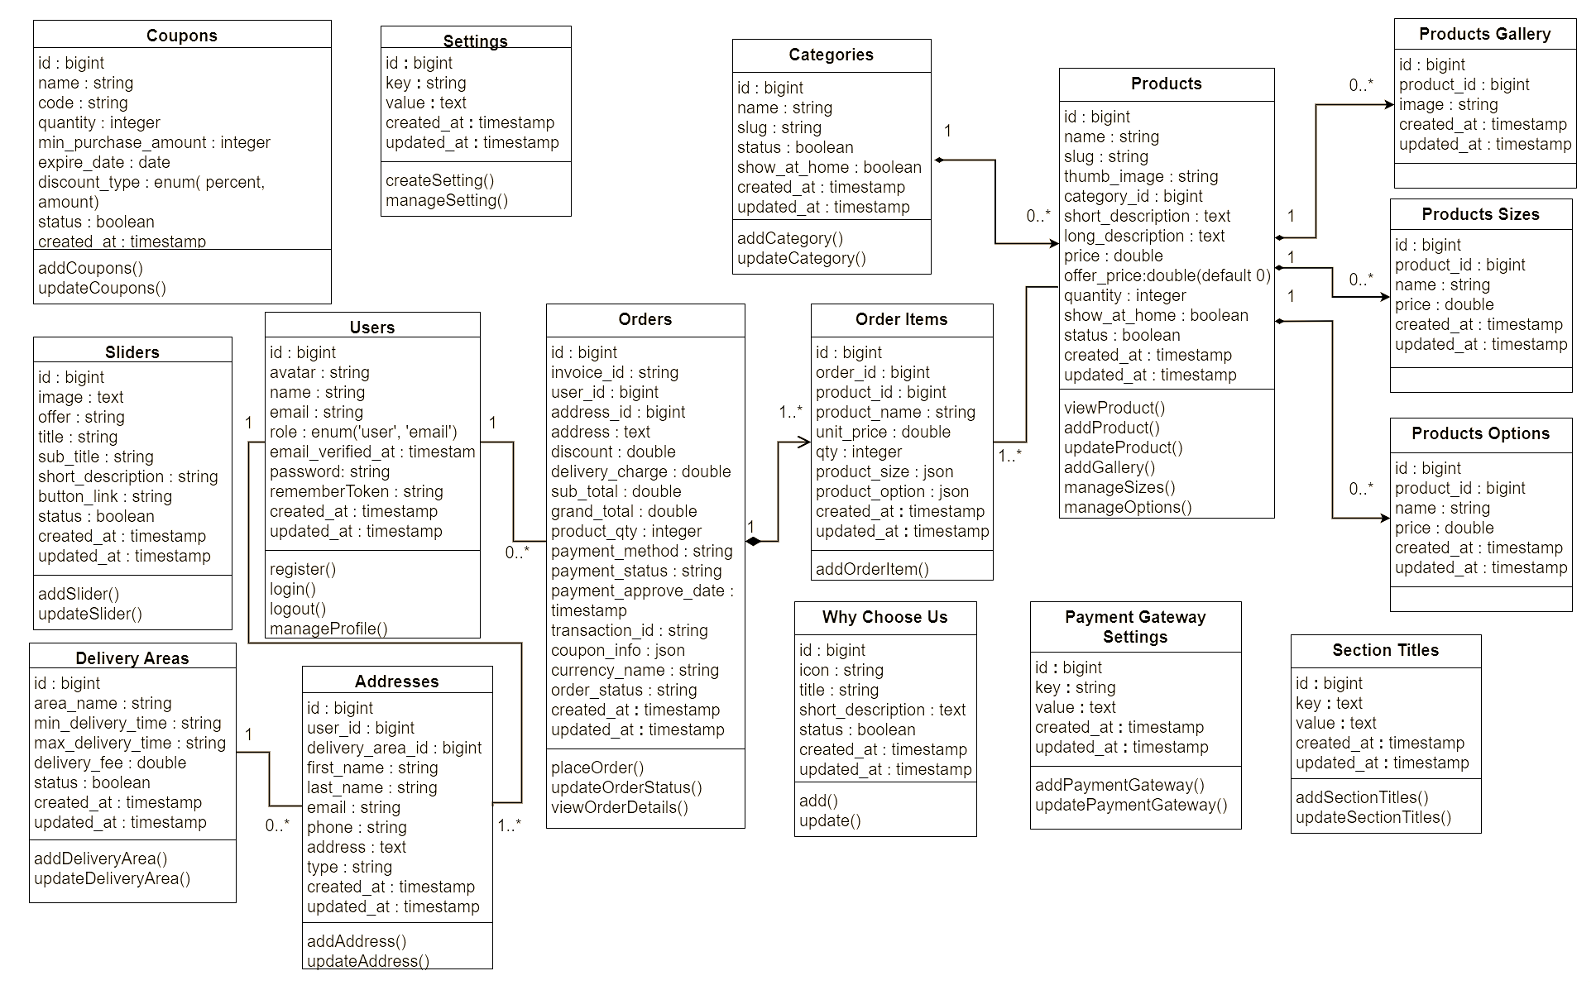

Slide 12


Project Demonstration
Owner / Restaurant Authority
Admin Dashboard
Now we will show Live interactions of our project.

Slide 13
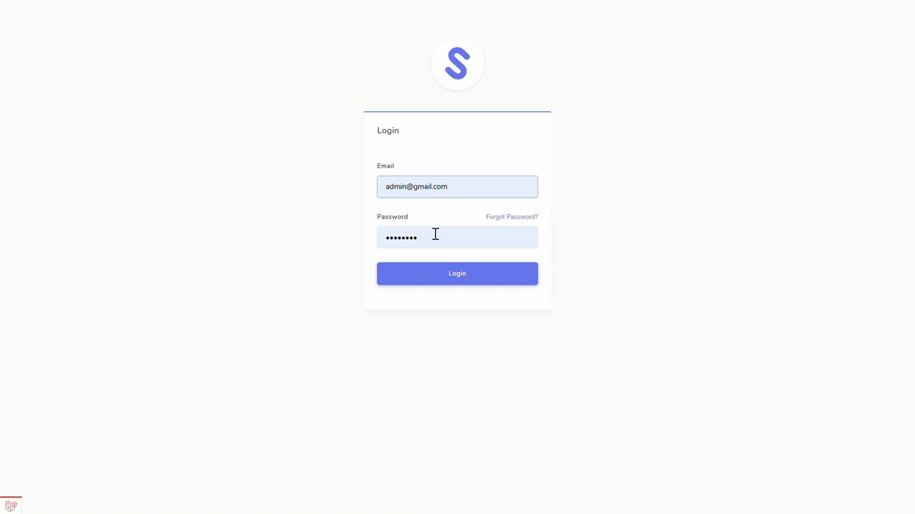

Slide 14


Project Demonstration
User Interactions
Frontend Live
Now we will show Live interactions of our project.

Slide 15


Slide 16

Testing
Testing Approaches:
Unit Testing: Testing individual functions like Cart operations and Payment processing.
Integration Testing: Ensuring seamless interaction between modules (e.g., Cart, Checkout, Payment).
User Acceptance Testing (UAT): Conducted with end-users to validate functionality.

Slide 17

Limitations
Limited Payment Gateways: Only supports Stripe and PayPal. Expanding options like Apple Pay and Google Pay could cater to more users.
No Real-Time Order Tracking: Lacks GPS-based order tracking, which is increasingly expected by customers.
Limited User Role Customization: Only two roles are available—User and Admin. Future versions could include more specialized roles like delivery personnel or managers.
Absence of a Recommendation Engine: Personalized recommendations based on user behavior could enhance user engagement.
Language and Localization Constraints: No support for multiple languages, limiting accessibility for non-English speakers.

Slide 18

Future Enhancements
1
2
Payment Gateway Expansion: Include additional payment options like Apple Pay, Google Pay, and cryptocurrency.
Advanced Inventory Management: Implement real-time stock tracking and supplier integration.
3
4
Real-Time Order Tracking: Integrate with GPS APIs for tracking deliveries in real time.
Expanded Role-Based Access: Allow for customizable roles with varying permissions.

Slide 19
Future Enhancements
5
6
Product Recommendation Engine: Add a recommendation engine to improve user engagement.
Multilingual and Localization Support: Enable language switching and regional formatting for international users.
7
8
AI-Based Chatbot for Customer Support: Provide automated support to handle common queries
Social Media Integration: Allow users to share orders and login via social media, enhancing marketing and engagement.

Slide 20
Team Contribution
Jannatur Noor Taspia | Ruhul Amin Sharif
Account and Profile Management(Frontend) | Account and Profile Management(Backend)
User Dashboard | Admin Dashboard
Slider Features(Admin + User) | Why choose us section ( Admin + User)
General Settings (Backend) | Category CRUD (Backend)
Coupon Features (Backend) | Product CRUD (Backend)
Product Gallery (Backend) | Product Variants (Backend)
Customer Address (Frontend) | Delivery Area Module (Admin)
Checkout Process | Cart Features
Payment Gateway (Stripe) | Payment Gateway (PayPal)
Order Handling | Authentication and Authorization
Print Functionality (User) | Product Searching (Frontend)
Order Placement Notification via email | Authentication and Authorization

Slide 21

Thank you

